Slide 1

Analyzing the Vulnerabilities of InsightFace against Blackbox Attacks: A Comprehensive Security Analysis
CISC 850: Project Proposal
Dr. Mohammad Zulkernine
Group:
Nafiz Sadman
Elyas Rashno
Kazi Amit Hasan

Slide 2





Background, Motivation, Proposed Work, Milestones, Limitation
How ?
Input
Detection
Extraction
Decision
Recognition

Slide 3

Background, Motivation, Proposed Work, Milestones, Limitation
What ?
Fake Input
Detection
Extraction
Manipulated Decision
Adversarial Recognition

Slide 4





Background, Motivation, Proposed Work, Milestones, Limitation
Where (CPS) ?
Traffic Camera^{[1]}
Smart Doors^{[2]}
CCTV Camera^{[3]}
Smart Homes^{[4]}
Smart Cities^{[5]}

Slide 5
Background, Motivation, Proposed Work, Milestones, Limitation
Increasing importance of biometric authentication in various sectors of society.
Face recognition technology is a convenient and efficient way of verifying an individual's identity.
The impact of vulnerable attacks on face recognition systems.
Financial losses
Damage to an individual's reputation
Promote the safe and responsible use of biometric authentication technologies.

Slide 6

Background, Motivation, Proposed Work, Milestones, Limitation
Why InsightFace?
An open-source deep learning project for face recognition.
Developed by the InsightFace* team at the Chinese University of Hong Kong.
Uses Convolutional Neural Networks (CNNs) to extract features from face images.
Uses extracted features to identify individuals.
A variety of face recognition tasks, including face verification, face identification, and face clustering.
Used ArcFace, MTCNN, RetinaFace, and ResNet models.
* https://insightface.ai/

Slide 7
Background, Motivation, Proposed Work, Milestones, Limitation
Why InsightFace?
Well reputed in the industry with 13.7k stars and 4.2K forks on GitHub
Achieved state-of-the-art accuracy in several benchmark datasets,
including LFW, MegaFace, and IJB-A
Trained on massive and various dataset making it capable of recognizing faces from different races and ethnicities
Handle pose, illumination, and occlusion variations, which are common challenges in face recognition

Slide 8
Background, Motivation, Proposed Work, Milestones, Limitation
Proposed Attacks
Face Swap[6]: Replacing the face of a person in an image or video with the face of another person.
Morphing[6]: Combining two or more faces to create a new face that looks like a blend of the original faces.
Deep Fake[7]: Creating a video or image that appears to be real, but is actually a manipulated or synthesized version of the original.
Presentation Attack (Physical)[8]: Using a physical object, such as a mask, to impersonate a legitimate user and gain access to a system.
Master Face Attack[8]: Creating a single synthetic face that can be used to fool multiple face recognition systems.

Slide 9
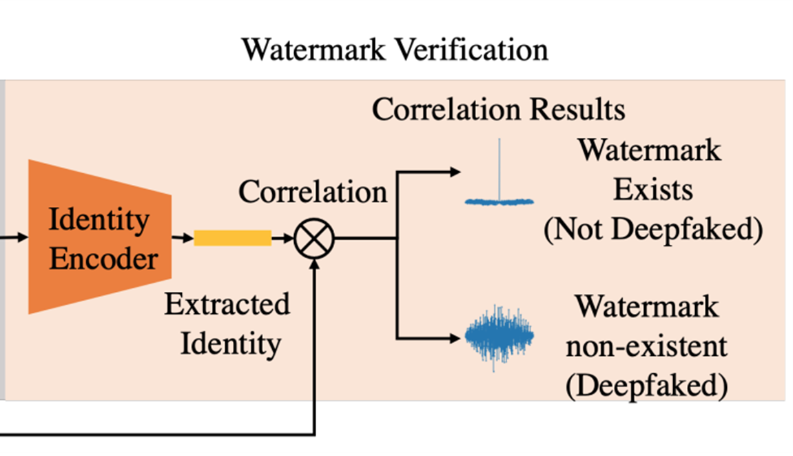
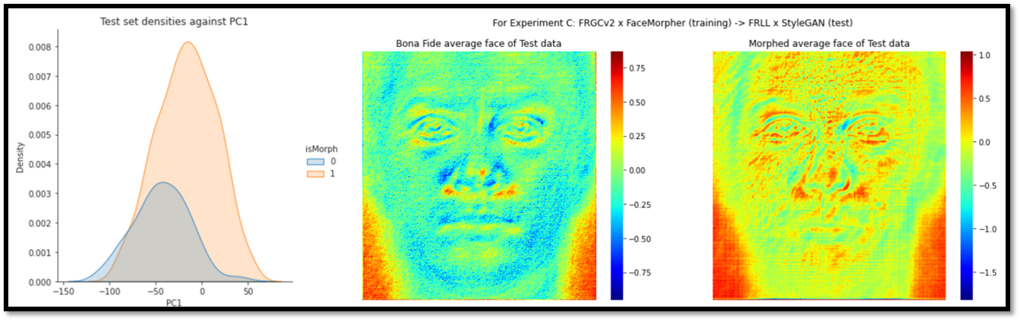
Background, Motivation, Proposed Work, Milestones, Limitation
Proposed Defense
Watermark Injection [7]
Linear Binary Pattern + PCA [6]

Slide 10

Background, Motivation, Proposed Work, Milestones, Limitation
Overall
Attack Model
Defense Model

Slide 11
Background, Motivation, Proposed Work, Milestones, Limitation
Attack Evaluation Metric
Confidentiality | Integrity | Availability | Authenticity | Detection | Delay | Response
Face Swap
Morphing
Deep Fake
Presentation
Master Face

Slide 12
Background, Motivation, Proposed Work, Milestones, Limitation
 | January | February | March | April
Project Planning
Literature Review
Paper Selection (Based on project)
Project Design and development
Experimentation
Attack Analysis
Articulation
Modification to improve security
Selecting the domain
Reviewing papers on CPSS
Selecting papers for presentation
Planning the high level design of project
Selecting test project and attack types
Trying different attacks
Complete the writeups
Introduce security in project

Slide 13
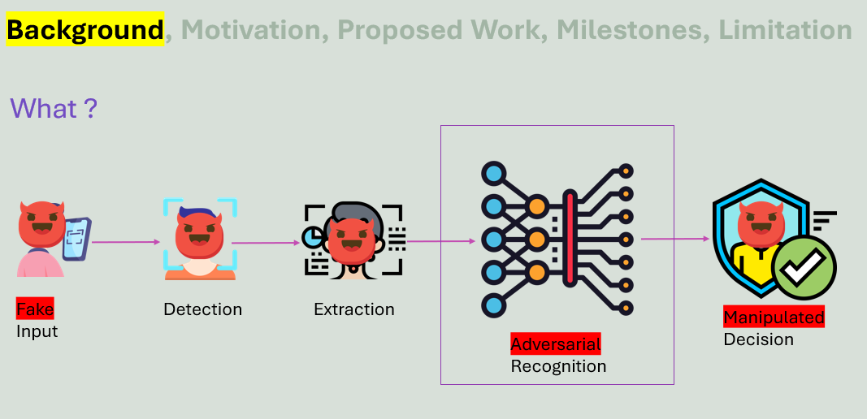
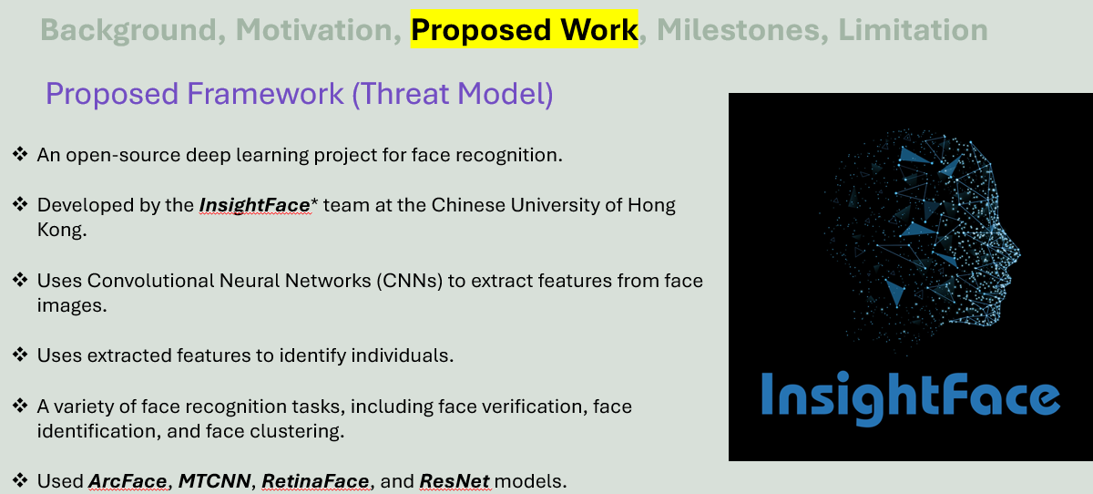
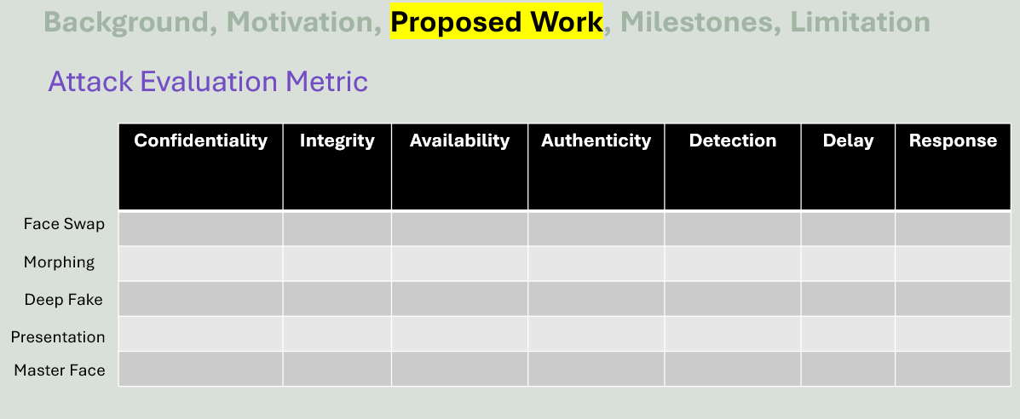
Summary

Slide 14
References
Tang, Yong, et al. "Vehicle detection and recognition for intelligent traffic surveillance system." Multimedia tools and applications 76 (2017): 5817-5832.
Waseem, Muhammad, et al. "Face recognition for smart door lock system using hierarchical network." 2020 International Conference on Computational Intelligence (ICCI). IEEE, 2020.
Celine, Jinu. "Face recognition in CCTV systems." 2019 International Conference on Smart Systems and Inventive Technology (ICSSIT). IEEE, 2019.
Zuo, Fei, and P. H. N. De With. "Real-time embedded face recognition for smart home." IEEE transactions on consumer Electronics 51.1 (2005): 183-190.
Othman, Nashwan Adnan, and Ilhan Aydin. "A face recognition method in the Internet of Things for security applications in smart homes and cities." 2018 6th International Istanbul Smart Grids and Cities Congress and Fair (ICSG). IEEE, 2018.
Dargaud, Laurine, et al. "A Principal Component Analysis-Based Approach for Single Morphing Attack Detection." Proceedings of the IEEE/CVF Winter Conference on Applications of Computer Vision. 2023.
Zhao, Yuan, et al. "Proactive Deepfake Defence via Identity Watermarking." Proceedings of the IEEE/CVF Winter Conference on Applications of Computer Vision. 2023.
Nguyen, Huy H., et al. "Master face attacks on face recognition systems." IEEE Transactions on Biometrics, Behavior, and Identity Science 4.3 (2022): 398-411

